Slide 1
COMPUTER NETWORK
Name: 麥聖嬰
Teacher: My Dear Great Teacher

Slide 2
Agenda
Computer network
WAN,MAN,LAN,PAN
Hardware
Network connecting devices
Network topology
Software
OSI MODEL
TCP/IP protocol
Windows Networking Commands

Slide 3
Computer network

Slide 4
What is Computer Network?
A computer network is a set of devices connected through links. A node can be computer, printer, or any other device capable of sending or receiving the data. The links connecting the nodes are known as communication channels.
Computer Network uses distributed processing in which task is divided among several computers. Instead, a single computer handles an entire task, each separate computer handles a subset.

Slide 5
Uses Of Computer Network
Resource sharing: Resource sharing is the sharing of resources such as programs, printers, and data among the users on the network without the requirement of the physical location of the resource and user.

Slide 6
Server-Client model: Computer networking is used in the server-client model. A server is a central computer used to store the information and maintained by the system administrator. Clients are the machines used to access the information stored in the server remotely.

Slide 7
Communication medium: Computer network behaves as a communication medium among the users. For example, a company contains more than one computer has an email system which the employees use for daily communication.

Slide 8
E-commerce: Computer network is also important in businesses. We can do the business over the internet. For example, amazon.com is doing their business over the internet, i.e., they are doing their business over the internet.

Slide 9
Computer Network Architecture
Computer Network Architecture is defined as the physical and logical design of the software, hardware, protocols, and media of the transmission of data. Simply we can say that how computers are organized and how tasks are allocated to the computer.

Slide 10
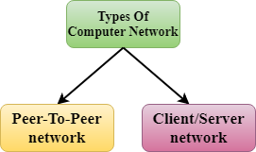
The two types of network architectures are used:
Peer-To-Peer network
Client/Server network

Slide 11
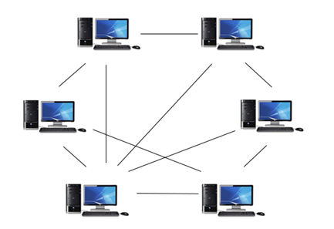
Peer-To-Peer network
Peer-To-Peer network is a network in which all the computers are linked together with equal privilege and responsibilities for processing the data.
Peer-To-Peer network is useful for small environments, usually up to 10 computers.
Peer-To-Peer network has no dedicated server.
Special permissions are assigned to each computer for sharing the resources, but this can lead to a problem if the computer with the resource is down.

Slide 12
Advantages Of Peer-To-Peer Network:
It is less costly as it does not contain any dedicated server.
If one computer stops working but, other computers will not stop working.
It is easy to set up and maintain as each computer manages itself.

Slide 13
Disadvantages Of Peer-To-Peer Network:
In the case of Peer-To-Peer network, it does not contain the centralized system . Therefore, it cannot back up the data as the data is different in different locations.
It has a security issue as the device is managed itself.

Slide 14
Client/Server Network
Client/Server network is a network model designed for the end users called clients, to access the resources such as songs, video, etc. from a central computer known as Server.
The central controller is known as a server while all other computers in the network are called clients.
A server performs all the major operations such as security and network management.
A server is responsible for managing all the resources such as files, directories, printer, etc.
All the clients communicate with each other through a server. For example, if client1 wants to send some data to client 2, then it first sends the request to the server for the permission. The server sends the response to the client 1 to initiate its communication with the client 2.

Slide 15
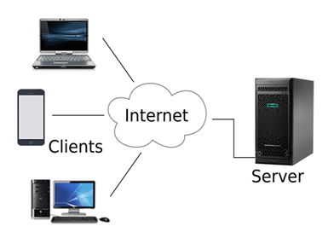

Slide 16
Advantages Of Client/Server network:
A Client/Server network contains the centralized system. Therefore we can back up the data easily.
A Client/Server network has a dedicated server that improves the overall performance of the whole system.
Security is better in Client/Server network as a single server administers the shared resources.
It also increases the speed of the sharing resources.

Slide 17
Disadvantages Of Client/Server network:
Client/Server network is expensive as it requires the server with large memory.
A server has a Network Operating System(NOS) to provide the resources to the clients, but the cost of NOS is very high.
It requires a dedicated network administrator to manage all the resources.

Slide 18
Computer Network Types
A computer network is a group of computers linked to each other that enables the computer to communicate with another computer and share their resources, data, and applications.

Slide 19
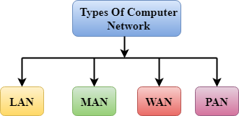
A computer network can be categorized by their size. A computer network is mainly of four types:
LAN(Local Area Network)
PAN(Personal Area Network)
MAN(Metropolitan Area Network)
WAN(Wide Area Network)

Slide 20
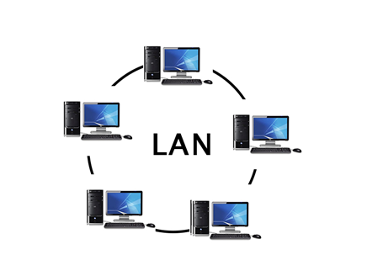
LAN(Local Area Network)
Local Area Network is a group of computers connected to each other in a small area such as building, office.
LAN is used for connecting two or more personal computers through a communication medium such as twisted pair, coaxial cable, etc.
It is less costly as it is built with inexpensive hardware such as hubs, network adapters, and ethernet cables.
The data is transferred at an extremely faster rate in Local Area Network.
Local Area Network provides higher security.

Slide 21
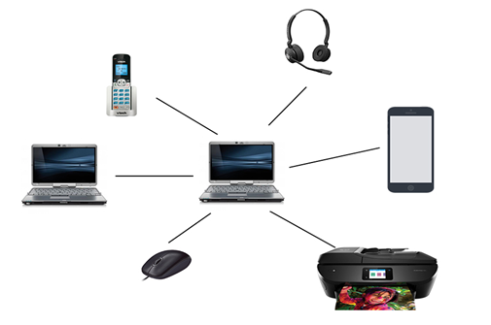
PAN(Personal Area Network)
Personal Area Network is a network arranged within an individual person, typically within a range of 10 meters.
Personal Area Network is used for connecting the computer devices of personal use is known as Personal Area Network.
Thomas Zimmerman was the first research scientist to bring the idea of the Personal Area Network.
Personal Area Network covers an area of 30 feet.
Personal computer devices that are used to develop the personal area network are the laptop, mobile phones, media player and play stations.

Slide 22
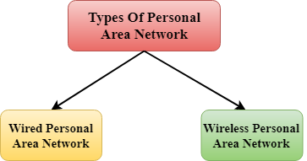
There are two types of Personal Area Network:
Wired Personal Area Network
Wireless Personal Area Network

Slide 23
Wireless Personal Area Network: Wireless Personal Area Network is developed by simply using wireless technologies such as WiFi, Bluetooth. It is a low range network.
Wired Personal Area Network: Wired Personal Area Network is created by using the USB.

Slide 24
Examples Of Personal Area Network:
Body Area Network: Body Area Network is a network that moves with a person. For example, a mobile network moves with a person. Suppose a person establishes a network connection and then creates a connection with another device to share the information.

Slide 25
Offline Network: An offline network can be created inside the home, so it is also known as a home network. A home network is designed to integrate the devices such as printers, computer, television but they are not connected to the internet.
Small Home Office: It is used to connect a variety of devices to the internet and to a corporate network using a VPN

Slide 26
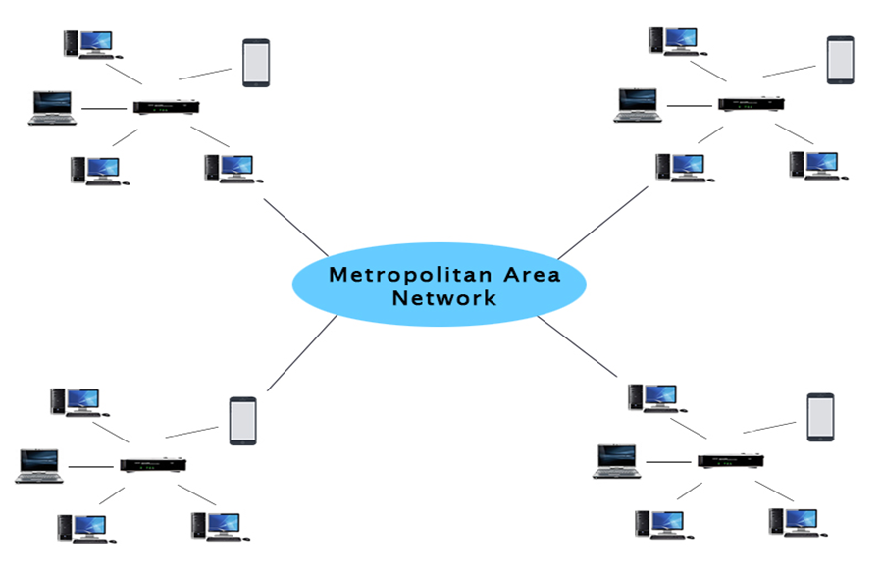
MAN(Metropolitan Area Network)
A metropolitan area network is a network that covers a larger geographic area by interconnecting a different LAN to form a larger network.
Government agencies use MAN to connect to the citizens and private industries.
In MAN, various LANs are connected to each other through a telephone exchange line.
The most widely used protocols in MAN are RS-232, Frame Relay, ATM, ISDN, OC-3, ADSL, etc.
It has a higher range than Local Area Network(LAN).

Slide 27
Uses Of Metropolitan Area Network:
MAN is used in communication between the banks in a city.
It can be used in an Airline Reservation.
It can be used in a college within a city.
It can also be used for communication in the military.

Slide 28
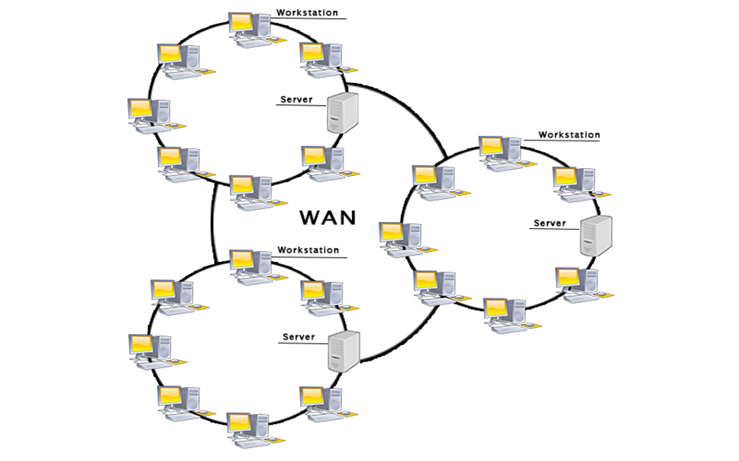
WAN(Wide Area Network)
A Wide Area Network is a network that extends over a large geographical area such as states or countries.
A Wide Area Network is quite bigger network than the LAN.
A Wide Area Network is not limited to a single location, but it spans over a large geographical area through a telephone line, fibre optic cable or satellite links.
The internet is one of the biggest WAN in the world.
A Wide Area Network is widely used in the field of Business, government, and education.

Slide 29
Examples Of Wide Area Network:
Mobile Broadband: A 4G network is widely used across a region or country.
Last mile: A telecom company is used to provide the internet services to the customers in hundreds of cities by connecting their home with fiber.
Private network: A bank provides a private network that connects the 44 offices. This network is made by using the telephone leased line provided by the telecom company.

Slide 30
Advantages Of Wide Area Network:
Geographical area: A Wide Area Network provides a large geographical area. Suppose if the branch of our office is in a different city then we can connect with them through WAN. The internet provides a leased line through which we can connect with another branch.
Centralized data: In case of WAN network, data is centralized. Therefore, we do not need to buy the emails, files or back up servers.

Slide 31
Get updated files: Software companies work on the live server. Therefore, the programmers get the updated files within seconds.
Exchange messages: In a WAN network, messages are transmitted fast. The web application like Facebook, Whatsapp, Skype allows you to communicate with friends.

Slide 32
Sharing of software and resources: In WAN network, we can share the software and other resources like a hard drive, RAM.
Global business: We can do the business over the internet globally.
High bandwidth: If we use the leased lines for our company then this gives the high bandwidth. The high bandwidth increases the data transfer rate which in turn increases the productivity of our company.

Slide 33
Disadvantages of Wide Area Network:
Security issue: A WAN network has more security issues as compared to LAN and MAN network as all the technologies are combined together that creates the security problem.
Needs Firewall & antivirus software: The data is transferred on the internet which can be changed or hacked by the hackers, so the firewall needs to be used. Some people can inject the virus in our system so antivirus is needed to protect from such a virus.

Slide 34
High Setup cost: An installation cost of the WAN network is high as it involves the purchasing of routers, switches.
Troubleshooting problems: It covers a large area so fixing the problem is difficult.

Slide 35
Internetwork
An internetwork is defined as two or more computer network LANs or WAN or computer network segments are connected using devices, and they are configured by a local addressing scheme. This process is known as internetworking.
An interconnection between public, private, commercial, industrial, or government computer networks can also be defined as internetworking.
An internetworking uses the internet protocol.
The reference model used for internetworking is Open System Interconnection(OSI).

Slide 36
Types Of Internetwork:
Extranet: An extranet is a communication network based on the internet protocol such as Transmission Control protocol and internet protocol. It is used for information sharing. The access to the extranet is restricted to only those users who have login credentials. An extranet is the lowest level of internetworking. It can be categorized as MAN, WAN or other computer networks. An extranet cannot have a single LAN, atleast it must have one connection to the external network.

Slide 37
Intranet: An intranet is a private network based on the internet protocol such as Transmission Control protocol and internet protocol. An intranet belongs to an organization which is only accessible by the organization's employee or members. The main aim of the intranet is to share the information and resources among the organization employees. An intranet provides the facility to work in groups and for teleconferences.

Slide 38
Intranet advantages:
Communication: It provides a cheap and easy communication. An employee of the organization can communicate with another employee through email, chat.
Time-saving: Information on the intranet is shared in real time, so it is time-saving.

Slide 39
Collaboration: Collaboration is one of the most important advantage of the intranet. The information is distributed among the employees of the organization and can only be accessed by the authorized user.
Platform independency: It is a neutral architecture as the computer can be connected to another device with different architecture.
Cost effective: People can see the data and documents by using the browser and distributes the duplicate copies over the intranet. This leads to a reduction in the cost.

Slide 40
HARDWARE

Slide 41
What are Network Connecting Devices?

Slide 42
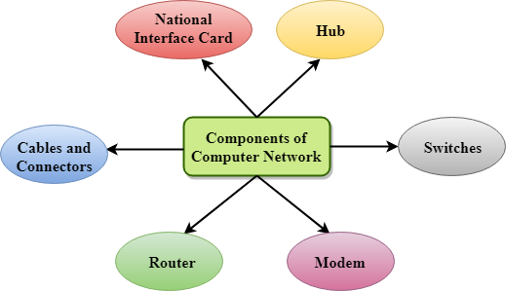
Types of network devices
Hub.
Switch.
Router.
Bridge.
Gateway.
Modem.
Repeater.
Access Point.

Slide 43
Hub
Hub is a central device that splits the network connection into multiple devices. When computer requests for information from a computer, it sends the request to the Hub. Hub distributes this request to all the interconnected computers.

Slide 44
Switches
Switch is a networking device that groups all the devices over the network to transfer the data to another device. A switch is better than Hub as it does not broadcast the message over the network, i.e., it sends the message to the device for which it belongs to. Therefore, we can say that switch sends the message directly from source to the destination.

Slide 45
Router
Router is a device that connects the LAN to the internet. The router is mainly used to connect the distinct networks or connect the internet to multiple computers.

Slide 46
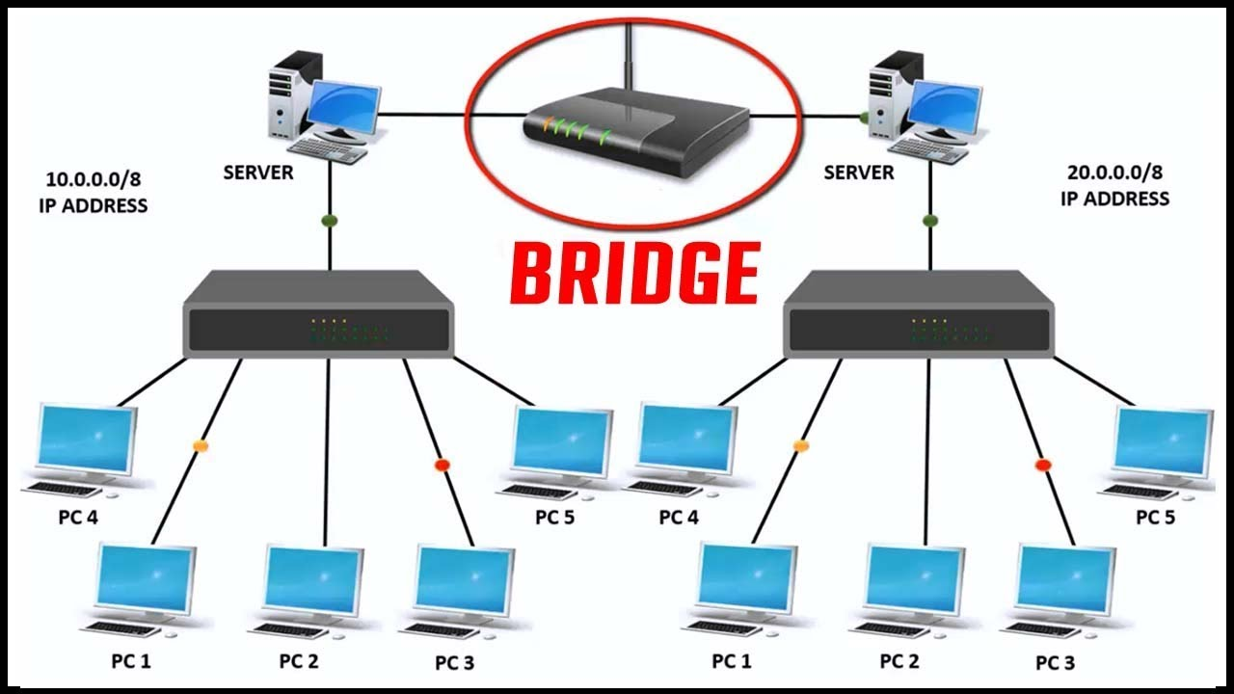
Types of network devices

Slide 47
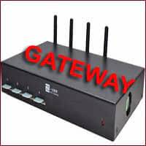
Types of network devices

Slide 48
Modem
Modem connects the computer to the internet over the existing telephone line. A modem is not integrated with the computer motherboard. A modem is a separate part on the PC slot found on the motherboard.

Slide 49
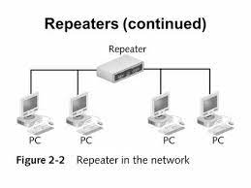
Types of network devices

Slide 50
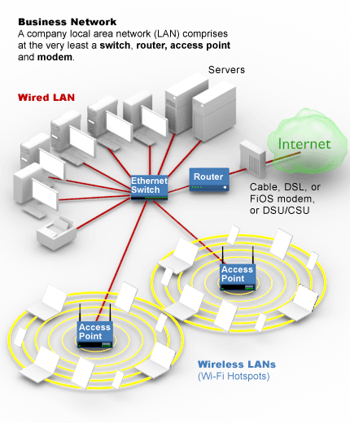
Types of network devices

Slide 51
What is Network Topology?
Topology defines the structure of the network of how all the components are interconnected to each other. There are two types of topology: physical and logical topology.

Slide 52
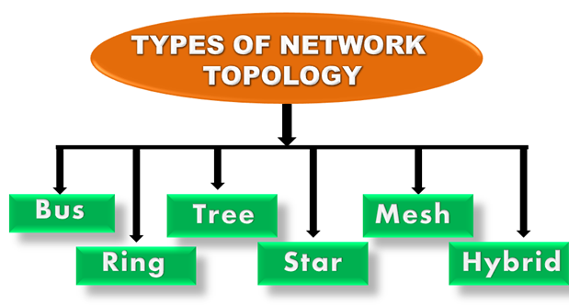
Types of Network Topology
Physical topology is the geometric representation of all the nodes in a network. There are six types of network topology which are Bus Topology, Ring Topology, Tree Topology, Star Topology, Mesh Topology, and Hybrid Topology.

Slide 53
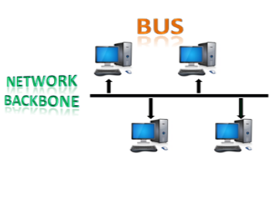
1) Bus Topology
The bus topology is designed in such a way that all the stations are connected through a single cable known as a backbone cable.
Each node is either connected to the backbone cable by drop cable or directly connected to the backbone cable.
When a node wants to send a message over the network, it puts a message over the network. All the stations available in the network will receive the message whether it has been addressed or not.
The bus topology is mainly used in 802.3 (ethernet) and 802.4 standard networks.
The configuration of a bus topology is quite simpler as compared to other topologies.
The backbone cable is considered as a "single lane" through which the message is broadcast to all the stations.
The most common access method of the bus topologies is CSMA (Carrier Sense Multiple Access).

Slide 54
Advantages of Bus topology:
Low-cost cable: In bus topology, nodes are directly connected to the cable without passing through a hub. Therefore, the initial cost of installation is low.
Moderate data speeds: Coaxial or twisted pair cables are mainly used in bus-based networks that support upto 10 Mbps.
Familiar technology: Bus topology is a familiar technology as the installation and troubleshooting techniques are well known, and hardware components are easily available.
Limited failure: A failure in one node will not have any effect on other nodes.

Slide 55
Disadvantages of Bus topology:
Extensive cabling: A bus topology is quite simpler, but still it requires a lot of cabling.
Difficult troubleshooting: It requires specialized test equipment to determine the cable faults. If any fault occurs in the cable, then it would disrupt the communication for all the nodes.
Signal interference: If two nodes send the messages simultaneously, then the signals of both the nodes collide with each other.
Reconfiguration difficult: Adding new devices to the network would slow down the network.
Attenuation: Attenuation is a loss of signal leads to communication issues. Repeaters are used to regenerate the signal.

Slide 56
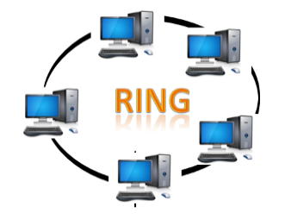
2) Ring Topology
Ring topology is like a bus topology, but with connected ends.
The node that receives the message from the previous computer will retransmit to the next node.
The data flows in one direction, i.e., it is unidirectional.
The data flows in a single loop continuously known as an endless loop.
It has no terminated ends, i.e., each node is connected to other node and having no termination point.
The data in a ring topology flow in a clockwise direction.
The most common access method of the ring topology is token passing.
Token passing: It is a network access method in which token is passed from one node to another node.
Token: It is a frame that circulates around the network.

Slide 57
Advantages of Ring topology:
Network Management: Faulty devices can be removed from the network without bringing the network down.
Product availability: Many hardware and software tools for network operation and monitoring are available.
Cost: Twisted pair cabling is inexpensive and easily available. Therefore, the installation cost is very low.
Reliable: It is a more reliable network because the communication system is not dependent on the single host computer.

Slide 58
Disadvantages of Ring topology:
Difficult troubleshooting: It requires specialized test equipment to determine the cable faults. If any fault occurs in the cable, then it would disrupt the communication for all the nodes.
Failure: The breakdown in one station leads to the failure of the overall network.
Reconfiguration difficult: Adding new devices to the network would slow down the network.
Delay: Communication delay is directly proportional to the number of nodes. Adding new devices increases the communication delay.

Slide 59
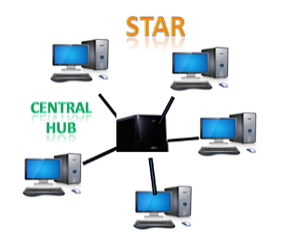
3) Star Topology
Star topology is an arrangement of the network in which every node is connected to the central hub, switch or a central computer.
The central computer is known as a server, and the peripheral devices attached to the server are known as clients.
Coaxial cable or RJ-45 cables are used to connect the computers.
Hubs or Switches are mainly used as connection devices in a physical star topology.
Star topology is the most popular topology in network implementation.

Slide 60
Advantages of Star topology
Efficient troubleshooting: Troubleshooting is quite efficient in a star topology as compared to bus topology. In a bus topology, the manager has to inspect the kilometers of cable. In a star topology, all the stations are connected to the centralized network. Therefore, the network administrator has to go to the single station to troubleshoot the problem.
Network control: Complex network control features can be easily implemented in the star topology. Any changes made in the star topology are automatically accommodated.

Slide 61
Limited failure: As each station is connected to the central hub with its own cable, therefore failure in one cable will not affect the entire network.
Familiar technology: Star topology is a familiar technology as its tools are cost-effective.
Easily expandable: It is easily expandable as new stations can be added to the open ports on the hub.
Cost effective: Star topology networks are cost-effective as it uses inexpensive coaxial cable.
High data speeds: It supports a bandwidth of approx 100Mbps. Ethernet 100BaseT is one of the most popular Star topology networks.

Slide 62
Disadvantages of Star topology
A Central point of failure: If the central hub or switch goes down, then all the connected nodes will not be able to communicate with each other.
Cable: Sometimes cable routing becomes difficult when a significant amount of routing is required.

Slide 63
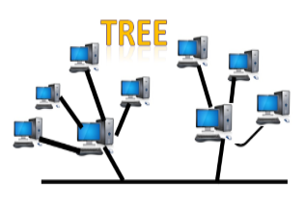
4) Tree topology
Tree topology combines the characteristics of bus topology and star topology.
A tree topology is a type of structure in which all the computers are connected with each other in hierarchical fashion.
The top-most node in tree topology is known as a root node, and all other nodes are the descendants of the root node.
There is only one path exists between two nodes for the data transmission. Thus, it forms a parent-child hierarchy.

Slide 64
Advantages of Tree topology
Support for broadband transmission: Tree topology is mainly used to provide broadband transmission, i.e., signals are sent over long distances without being attenuated.
Easily expandable: We can add the new device to the existing network. Therefore, we can say that tree topology is easily expandable.

Slide 65
Easily manageable: In tree topology, the whole network is divided into segments known as star networks which can be easily managed and maintained.
Error detection: Error detection and error correction are very easy in a tree topology.
Limited failure: The breakdown in one station does not affect the entire network.
Point-to-point wiring: It has point-to-point wiring for individual segments.

Slide 66
Disadvantages of Tree topology
Difficult troubleshooting: If any fault occurs in the node, then it becomes difficult to troubleshoot the problem.
High cost: Devices required for broadband transmission are very costly.
Failure: A tree topology mainly relies on main bus cable and failure in main bus cable will damage the overall network.
Reconfiguration difficult: If new devices are added, then it becomes difficult to reconfigure.

Slide 67
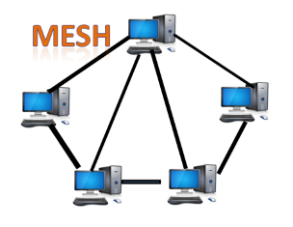
5) Mesh topology
Mesh technology is an arrangement of the network in which computers are interconnected with each other through various redundant connections.
There are multiple paths from one computer to another computer.
It does not contain the switch, hub or any central computer which acts as a central point of communication.
The Internet is an example of the mesh topology.
Mesh topology is mainly used for WAN implementations where communication failures are a critical concern.
Mesh topology is mainly used for wireless networks.
Mesh topology can be formed by using the formula: Number of cables = (n*(n-1))/2;

Slide 68
Mesh topology is divided into two categories:
Fully connected mesh topology
Partially connected mesh topology

Slide 69
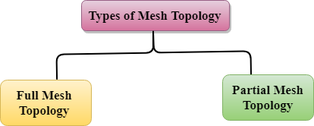
Full Mesh Topology: In a full mesh topology, each computer is connected to all the computers available in the network.
Partial Mesh Topology: In a partial mesh topology, not all but certain computers are connected to those computers with which they communicate frequently.

Slide 70
Advantages of Mesh topology:
Reliable: The mesh topology networks are very reliable as if any link breakdown will not affect the communication between connected computers.
Fast Communication: Communication is very fast between the nodes.
Easier Reconfiguration: Adding new devices would not disrupt the communication between other devices.

Slide 71
Disadvantages of Mesh topology
Cost: A mesh topology contains a large number of connected devices such as a router and more transmission media than other topologies.
Management: Mesh topology networks are very large and very difficult to maintain and manage. If the network is not monitored carefully, then the communication link failure goes undetected.
Efficiency: In this topology, redundant connections are high that reduces the efficiency of the network.

Slide 72
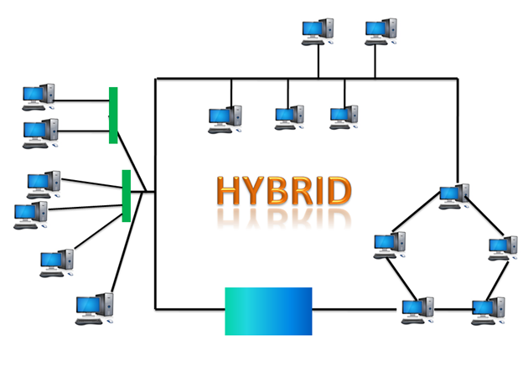
6) Hybrid Topology
The combination of various different topologies is known as Hybrid topology.
A Hybrid topology is a connection between different links and nodes to transfer the data.
When two or more different topologies are combined together is termed as Hybrid topology and if similar topologies are connected with each other will not result in Hybrid topology. For example, if there exist a ring topology in one branch of ICICI bank and bus topology in another branch of ICICI bank, connecting these two topologies will result in Hybrid topology.

Slide 73
Advantages of Hybrid Topology
Reliable: If a fault occurs in any part of the network will not affect the functioning of the rest of the network.
Scalable: Size of the network can be easily expanded by adding new devices without affecting the functionality of the existing network.

Slide 74
Flexible: This topology is very flexible as it can be designed according to the requirements of the organization.
Effective: Hybrid topology is very effective as it can be designed in such a way that the strength of the network is maximized and weakness of the network is minimized.

Slide 75
Disadvantages of Hybrid topology
Complex design: The major drawback of the Hybrid topology is the design of the Hybrid network. It is very difficult to design the architecture of the Hybrid network.
Costly Hub: The Hubs used in the Hybrid topology are very expensive as these hubs are different from usual Hubs used in other topologies.
Costly infrastructure: The infrastructure cost is very high as a hybrid network requires a lot of cabling, network devices, etc.

Slide 76
SOFTWARE

Slide 77
Software
Software is a set of instructions, data or programs used to operate computers and execute specific tasks. It is the opposite of hardware, which describes the physical aspects of a computer. Software is a generic term used to refer to applications, scripts and programs that run on a device. It can be thought of as the variable part of a computer, while hardware is the invariable part.

Slide 78
The two main categories of software
Application software
System software

Slide 79
Application software
An application program (software application, or application, or app for short) is a computer program designed to carry out a specific task other than one relating to the operation of the computer itself,^{[1]} typically to be used by end-users.^{[2]} Word processors, media players, and accounting software are examples. The collective noun "application software" refers to all applications collectively.^{[3]} The other principal classifications of software are system software, relating to the operation of the computer, and utility software ("utilities").

Slide 80
System software
System software is a type of computer program that is designed to run a computer's hardware and application programs. If we think of the computer system as a layered model, the system software is the interface between the hardware and user applications. The operating system is the best-known example of system software.

Slide 81
Computer Network Models
A communication subsystem is a complex piece of Hardware and software. Early attempts for implementing the software for such subsystems were based on a single, complex, unstructured program with many interacting components. The resultant software was very difficult to test and modify. To overcome such problem, the ISO has developed a layered approach. In a layered approach, networking concept is divided into several layers, and each layer is assigned a particular task. Therefore, we can say that networking tasks depend upon the layers.

Slide 82
OSI Model
OSI stands for Open System Interconnection is a reference model that describes how information from a software application in one computer moves through a physical medium to the software application in another computer.
OSI consists of seven layers, and each layer performs a particular network function.
OSI model was developed by the International Organization for Standardization (ISO) in 1984, and it is now considered as an architectural model for the inter-computer communications.
OSI model divides the whole task into seven smaller and manageable tasks. Each layer is assigned a particular task.
Each layer is self-contained, so that task assigned to each layer can be performed independently.

Slide 83
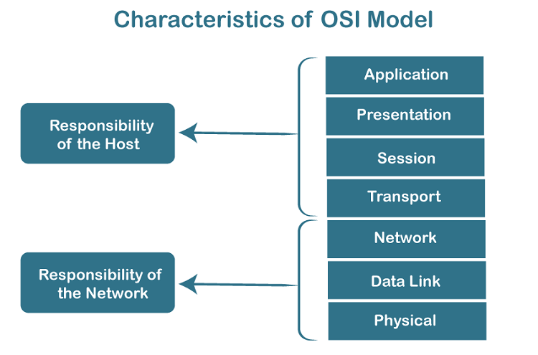
Characteristics of OSI Model:

Slide 84
The OSI model is divided into two layers: upper layers and lower layers.
The upper layer of the OSI model mainly deals with the application related issues, and they are implemented only in the software. The application layer is closest to the end user. Both the end user and the application layer interact with the software applications. An upper layer refers to the layer just above another layer.
The lower layer of the OSI model deals with the data transport issues. The data link layer and the physical layer are implemented in hardware and software. The physical layer is the lowest layer of the OSI model and is closest to the physical medium. The physical layer is mainly responsible for placing the information on the physical medium.

Slide 85
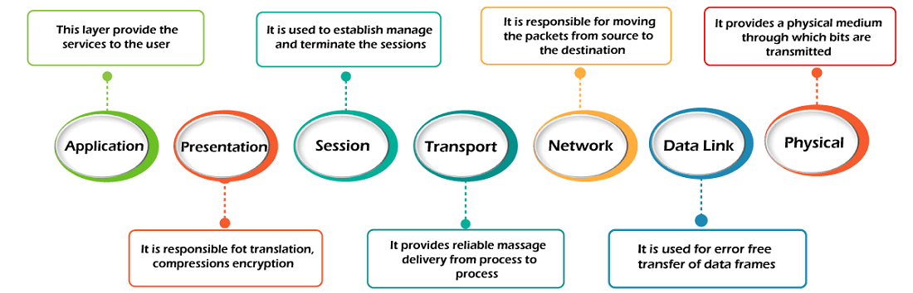
7 Layers of OSI Model
Physical Layer
Data-Link Layer
Network Layer
Transport Layer
Session Layer
Presentation Layer
Application Layer

Slide 86
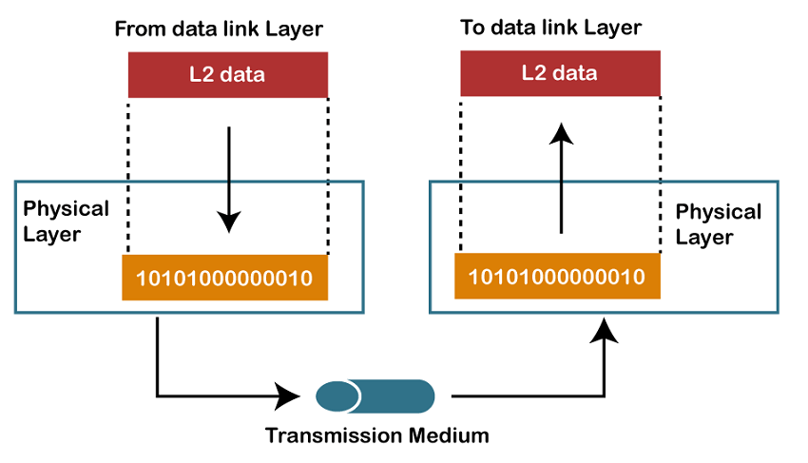
1) Physical layer
The main functionality of the physical layer is to transmit the individual bits from one node to another node.
It is the lowest layer of the OSI model.
It establishes, maintains and deactivates the physical connection.
It specifies the mechanical, electrical and procedural network interface specifications.

Slide 87
Functions of a Physical layer:
Line Configuration: It defines the way how two or more devices can be connected physically.
Data Transmission: It defines the transmission mode whether it is simplex, half-duplex or full-duplex mode between the two devices on the network.
Topology: It defines the way how network devices are arranged.
Signals: It determines the type of the signal used for transmitting the information.

Slide 88
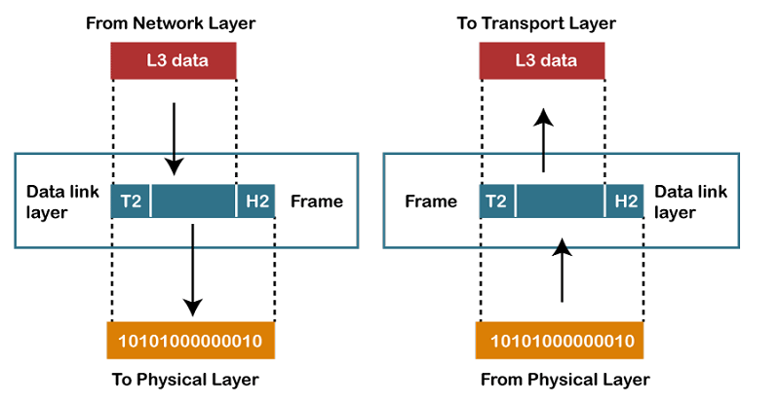
2) Data-Link Layer
This layer is responsible for the error-free transfer of data frames.
It defines the format of the data on the network.
It provides a reliable and efficient communication between two or more devices.
It is mainly responsible for the unique identification of each device that resides on a local network.

Slide 89

Functions of the Data-link layer
Framing: The data link layer translates the physical's raw bit stream into packets known as Frames. The Data link layer adds the header and trailer to the frame. The header which is added to the frame contains the hardware destination and source address.
Physical Addressing: The Data link layer adds a header to the frame that contains a destination address. The frame is transmitted to the destination address mentioned in the header.
Flow Control: Flow control is the main functionality of the Data-link layer. It is the technique through which the constant data rate is maintained on both the sides so that no data get corrupted. It ensures that the transmitting station such as a server with higher processing speed does not exceed the receiving station, with lower processing speed.

Slide 90
Error Control: Error control is achieved by adding a calculated value CRC (Cyclic Redundancy Check) that is placed to the Data link layer's trailer which is added to the message frame before it is sent to the physical layer. If any error seems to occur, then the receiver sends the acknowledgment for the retransmission of the corrupted frames.
Access Control: When two or more devices are connected to the same communication channel, then the data link layer protocols are used to determine which device has control over the link at a given time.

Slide 91
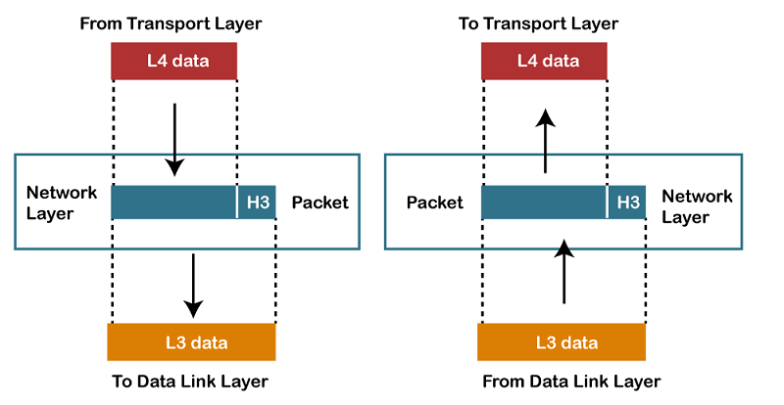
3) Network Layer
It is a layer 3 that manages device addressing, tracks the location of devices on the network.
It determines the best path to move data from source to the destination based on the network conditions, the priority of service, and other factors.
The Data link layer is responsible for routing and forwarding the packets.
Routers are the layer 3 devices, they are specified in this layer and used to provide the routing services within an internetwork.
The protocols used to route the network traffic are known as Network layer protocols. Examples of protocols are IP and Ipv6.

Slide 92
Functions of Network Layer
Internetworking: An internetworking is the main responsibility of the network layer. It provides a logical connection between different devices.
Addressing: A Network layer adds the source and destination address to the header of the frame. Addressing is used to identify the device on the internet.
Routing: Routing is the major component of the network layer, and it determines the best optimal path out of the multiple paths from source to the destination.
Packetizing: A Network Layer receives the packets from the upper layer and converts them into packets. This process is known as Packetizing. It is achieved by internet protocol (IP).

Slide 93
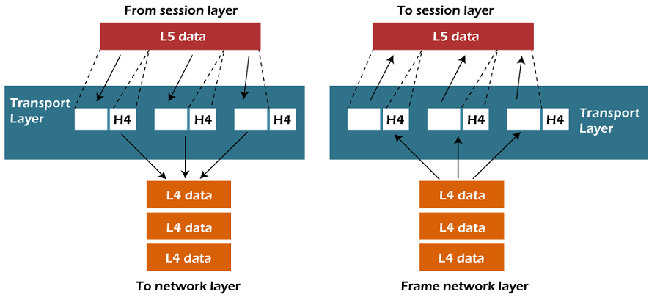
4) Transport Layer
The Transport layer is a Layer 4 ensures that messages are transmitted in the order in which they are sent and there is no duplication of data.
The main responsibility of the transport layer is to transfer the data completely.
It receives the data from the upper layer and converts them into smaller units known as segments.
This layer can be termed as an end-to-end layer as it provides a point-to-point connection between source and destination to deliver the data reliably.

Slide 94
The two protocols used in this layer are:
Transmission Control Protocol
It is a standard protocol that allows the systems to communicate over the internet.
It establishes and maintains a connection between hosts.
When data is sent over the TCP connection, then the TCP protocol divides the data into smaller units known as segments. Each segment travels over the internet using multiple routes, and they arrive in different orders at the destination. The transmission control protocol reorders the packets in the correct order at the receiving end.
User Datagram Protocol
User Datagram Protocol is a transport layer protocol.
It is an unreliable transport protocol as in this case receiver does not send any acknowledgment when the packet is received, the sender does not wait for any acknowledgment. Therefore, this makes a protocol unreliable.

Slide 95
Functions of Transport Layer:
Service-point addressing: Computers run several programs simultaneously due to this reason, the transmission of data from source to the destination not only from one computer to another computer but also from one process to another process. The transport layer adds the header that contains the address known as a service-point address or port address. The responsibility of the network layer is to transmit the data from one computer to another computer and the responsibility of the transport layer is to transmit the message to the correct process.

Slide 96
Segmentation and reassembly: When the transport layer receives the message from the upper layer, it divides the message into multiple segments, and each segment is assigned with a sequence number that uniquely identifies each segment. When the message has arrived at the destination, then the transport layer reassembles the message based on their sequence numbers.

Slide 97
Connection control: Transport layer provides two services Connection-oriented service and connectionless service. A connectionless service treats each segment as an individual packet, and they all travel in different routes to reach the destination. A connection-oriented service makes a connection with the transport layer at the destination machine before delivering the packets. In connection-oriented service, all the packets travel in the single route.
Flow control: The transport layer also responsible for flow control but it is performed end-to-end rather than across a single link.
Error control: The transport layer is also responsible for Error control. Error control is performed end-to-end rather than across the single link. The sender transport layer ensures that message reach at the destination without any error.

Slide 98
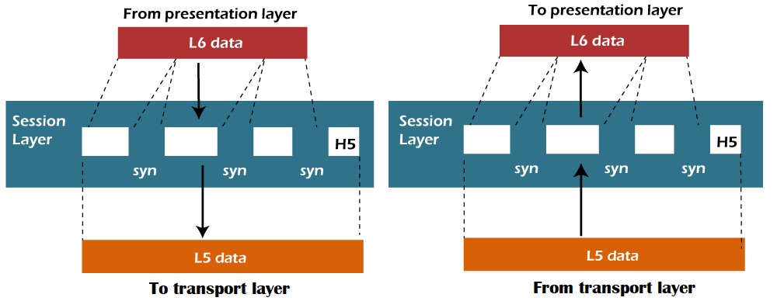
5) Session Layer
It is a layer 3 in the OSI model.
The Session layer is used to establish, maintain and synchronizes the interaction between communicating devices.

Slide 99
Functions of Session layer:
Dialog control: Session layer acts as a dialog controller that creates a dialog between two processes or we can say that it allows the communication between two processes which can be either half-duplex or full-duplex.
Synchronization: Session layer adds some checkpoints when transmitting the data in a sequence. If some error occurs in the middle of the transmission of data, then the transmission will take place again from the checkpoint. This process is known as Synchronization and recovery.

Slide 100
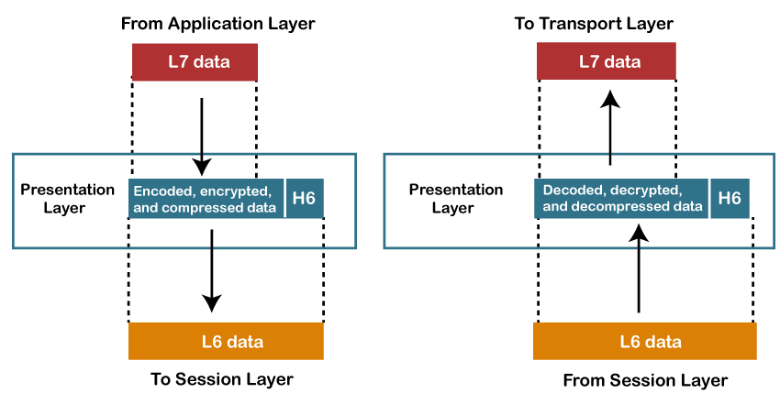
6) Presentation Layer
A Presentation layer is mainly concerned with the syntax and semantics of the information exchanged between the two systems.
It acts as a data translator for a network.
This layer is a part of the operating system that converts the data from one presentation format to another format.
The Presentation layer is also known as the syntax layer.

Slide 101
Functions of Presentation layer:
Translation: The processes in two systems exchange the information in the form of character strings, numbers and so on. Different computers use different encoding methods, the presentation layer handles the interoperability between the different encoding methods. It converts the data from sender-dependent format into a common format and changes the common format into receiver-dependent format at the receiving end.
Encryption: Encryption is needed to maintain privacy. Encryption is a process of converting the sender-transmitted information into another form and sends the resulting message over the network.
Compression: Data compression is a process of compressing the data, i.e., it reduces the number of bits to be transmitted. Data compression is very important in multimedia such as text, audio, video.

Slide 102
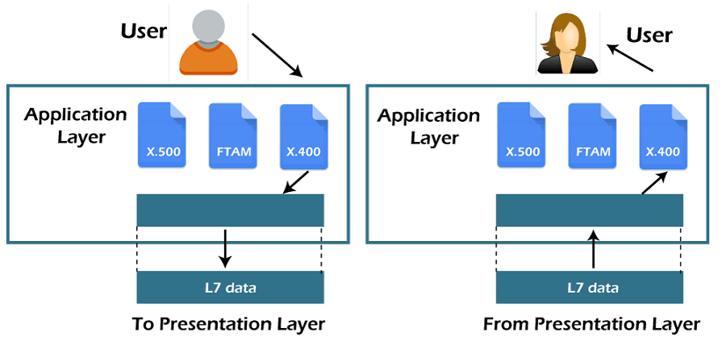
7) Application Layer
An application layer serves as a window for users and application processes to access network service.
It handles issues such as network transparency, resource allocation, etc.
An application layer is not an application, but it performs the application layer functions.
This layer provides the network services to the end-users.

Slide 103
Functions of Application layer:
File transfer, access, and management (FTAM): An application layer allows a user to access the files in a remote computer, to retrieve the files from a computer and to manage the files in a remote computer.
Mail services: An application layer provides the facility for email forwarding and storage.
Directory services: An application provides the distributed database sources and is used to provide that global information about various objects.

Slide 104
TCP/IP
The TCP/IP model was developed prior to the OSI model.
The TCP/IP model is not exactly similar to the OSI model.
The TCP/IP model consists of five layers: the application layer, transport layer, network layer, data link layer and physical layer.
The first four layers provide physical standards, network interface, internetworking, and transport functions that correspond to the first four layers of the OSI model and these four layers are represented in TCP/IP model by a single layer called the application layer.
TCP/IP is a hierarchical protocol made up of interactive modules, and each of them provides specific functionality.

Slide 105
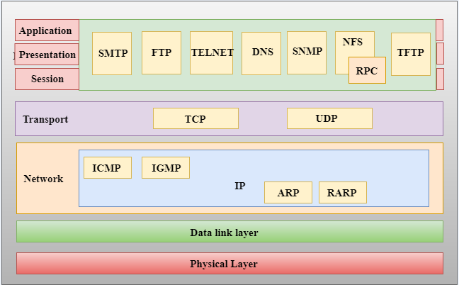
TCP/IP

Slide 106
Network Access Layer
A network layer is the lowest layer of the TCP/IP model.
A network layer is the combination of the Physical layer and Data Link layer defined in the OSI reference model.
It defines how the data should be sent physically through the network.
This layer is mainly responsible for the transmission of the data between two devices on the same network.
The functions carried out by this layer are encapsulating the IP datagram into frames transmitted by the network and mapping of IP addresses into physical addresses.
The protocols used by this layer are ethernet, token ring, FDDI, X.25, frame relay.

Slide 107
Internet Layer
An internet layer is the second layer of the TCP/IP model.
An internet layer is also known as the network layer.
The main responsibility of the internet layer is to send the packets from any network, and they arrive at the destination irrespective of the route they take.

Slide 108
IP Protocol
IP protocol is used in this layer, and it is the most significant part of the entire TCP/IP suite.

Slide 109
IP Addressing: This protocol implements logical host addresses known as IP addresses. The IP addresses are used by the internet and higher layers to identify the device and to provide internetwork routing.

Slide 110
Host-to-host communication: It determines the path through which the data is to be transmitted.

Slide 111
Data Encapsulation and Formatting: An IP protocol accepts the data from the transport layer protocol. An IP protocol ensures that the data is sent and received securely, it encapsulates the data into message known as IP datagram.

Slide 112
Fragmentation and Reassembly: The limit imposed on the size of the IP datagram by data link layer protocol is known as Maximum Transmission unit (MTU). If the size of IP datagram is greater than the MTU unit, then the IP protocol splits the datagram into smaller units so that they can travel over the local network. Fragmentation can be done by the sender or intermediate router. At the receiver side, all the fragments are reassembled to form an original message.

Slide 113
Routing: When IP datagram is sent over the same local network such as LAN, MAN, WAN, it is known as direct delivery. When source and destination are on the distant network, then the IP datagram is sent indirectly. This can be accomplished by routing the IP datagram through various devices such as routers.

Slide 114
ARP Protocol
ARP stands for Address Resolution Protocol.
ARP is a network layer protocol which is used to find the physical address from the IP address.

Slide 115
The two terms are mainly associated with the ARP Protocol:
ARP request: When a sender wants to know the physical address of the device, it broadcasts the ARP request to the network.
ARP reply: Every device attached to the network will accept the ARP request and process the request, but only recipient recognize the IP address and sends back its physical address in the form of ARP reply. The recipient adds the physical address both to its cache memory and to the datagram header

